Slide 1
Module 5 Guidance Notes (5.4) Functions
COMP2113 Programming Technologies
ENGG1340 Computer Programming II

Slide 2
Problems
flow of control and functions

Slide 3
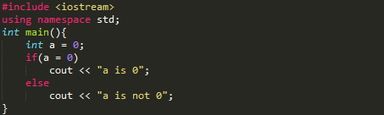
Problem 1
051001
Is there any error in the following program? if no, what is the output? (Try to answer before compiling and running the program.)

Slide 4
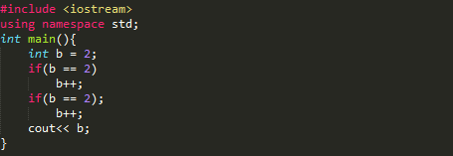
Problem 2
051002
What is the output of this program? Can you explain why?

Slide 5
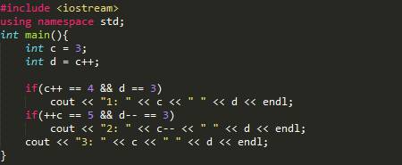
Problem 3
051003
What is the output of this program? (Try to answer before compiling and running the program.)

Slide 6
Problem 4
051004
Recall that we wrote a program that reads in three integers and outputs the maximum in Module 3. Draw the flowchart for a program that reads in three integers and outputs the minimum.

Slide 7
Problem 5
051005
Write the corresponding program to the flowchart of problem 4.

Slide 8
Problem 6
051006
Write a program with an if-else statement that outputs the word High if the value of the variable score is greater than 100 and Low if the value of score is at most 100. The variable score is of type int.

Slide 9
Problem 7
051007
Write a program to determine the outcome of the paper-rock-scissor game. Each of two users types in either P, R, or S. The program then announces the winner as well as the basis for determining the winner: Paper covers rock, Rock breaks scissors, Scissors cut paper, or Nobody wins. Be sure to allow the users to use lowercase as well as uppercase letters.

Slide 10
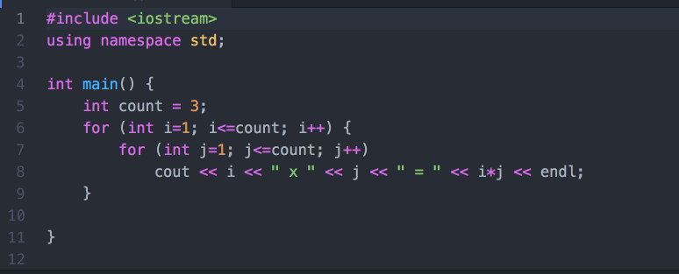
Problem 8
051008
What is the output of the following program? Can you explain the output?

Slide 11
Problem 9
051009
Write a program that reads in five integers and that outputs the sum of all integers greater than zero, the sum of all the integers less than zero, and the sum of all the integers, whether positive, negative, or zero. The user enters the numbers just once each and the user can enter them in any order. Your program should not ask the user to enter the positive numbers and the negative numbers separately.

Slide 12
Problem 10
051010
Write a program that will output the following pattern. Use two for loops to achieve the output
0123456 012345 01234 0123 012 01 0

Slide 13
Problem 11
051011
Write a program with a function that takes one argument of type double. The function returns the character value P if its argument is positive and returns N if its argument is zero or negative. In the main function of your program, call this function to test its behavior.

Slide 14
Problem 12
051012
Write a program with a function that takes one argument of type int and one argument of type double. The function returns a value of type double that is the average of the two arguments.

Slide 15
Problem 13
051013
Greek mathematicians took a special interest in numbers that are equal to the sum of their proper divisors (a proper divisor of n is any divisor less than n itself). They called such numbers perfect numbers. For example, 6 is a perfect number because it is the sum of 1, 2, and 3, which are the integers less than 6 that divide evenly into 6. Similarly, 28 is a perfect number because it is the sum of 1, 2, 4, 7, and 14. Write a function that determines if a given number is a perfect number. Your function should take an int as a parameter and return a value of type bool.

Slide 16
Problem 14
051014
Write a program that finds all the perfect numbers between two limits entered by the user. Use your function from Problem 13.

Slide 17
Problem 15
051015
A liter is 0.264179 gallons. Write a program that will read in the number of liters of gasoline consumed by the user's car and the number of miles the car delivered, and will then output the number of miles per gallon the car gets. Your program should allow the user to repeat this calculation as many times as the user wishes. Define a function to compute the number of miles per gallon.
Modify your program so that it will take input data for two cars and output the number of miles per gallon delivered by each car. Your program will also announce which car has the best fuel efficiency (highest number of miles per gallon).

Slide 18
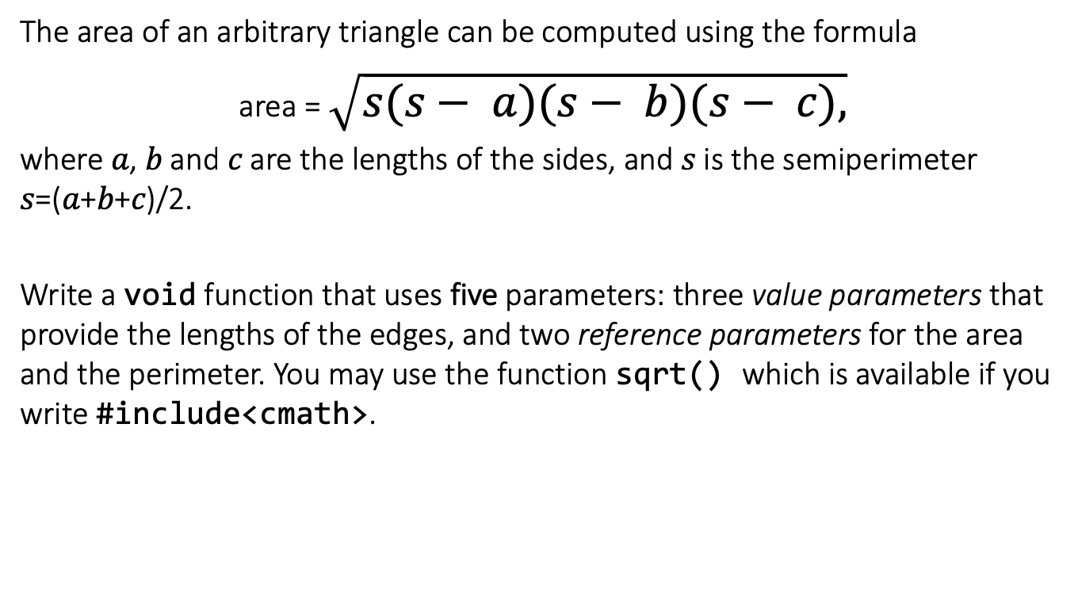
Problem 16
051016
The area of an arbitrary triangle can be computed using the formula
area = $\sqrt{s(s− a)(s− b)(s− c),}$
where 𝑎, 𝑏 and 𝑐 are the lengths of the sides, and 𝑠 is the semiperimeter 𝑠=(𝑎+𝑏+𝑐)/2.
Write a void function that uses five parameters: three value parameters that provide the lengths of the edges, and two reference parameters for the area and the perimeter. You may use the function sqrt() which is available if you write #include<cmath>.

Slide 19
Problem 17
051017
What is the output of the following program? Explain.
#include <iostream>
using namespace std;
int main()
{
int a = -15, b;
a--;
cout << "a = " << a << endl;
{
int b = 7;
b = 2*a*b;
}
int result = a+b;
cout << "result = " << result << endl;
}

Slide 20
CHALLENGES
Optional.
For those who would like to challenge yourselves. Even for those of you who are beginners in C++ programming, it’s highly recommended for you to take a look at these problems and try to tackle them as well.
You are welcome to discuss these problems in the Moodle forum.

Slide 21
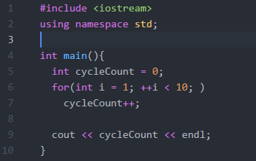
Challenge 1
052001
What will be the output of this program? Or will it loop forever? Try to think about the final value of “cycleCount” before compiling this program.

Slide 22
Challenge 2
052002
Redo Problem 12. This time, use ONLY one statement in your function to accomplish the same task.

Slide 23
Challenge 3
052003
Write a program to print the following diamond pattern of ‘*’.
*
***
*****
*******
*****
***
*

Slide 24
Challenge 4
052004
Write a function which checks if a number is prime or not. (What’s the return type of the function?)

Slide 25
Challenge 5
052005
Using the function created in Challenge 4, create another function that print all prime numbers p within a given range defined by parameters x, y, where x <= p <= y.
Can you think of a faster implementation of the function?

Slide 26
Challenge 6
052006
Extend the program you have written for Problem 14, output also whether the perfect numbers found are prime numbers.

